Slide 1
EDP Architecture
DR suggestion:
We should add a box for digital products, also downstream dependencies?
We should also distinguish between production solutions and ‘discovery solutions’ one can only access production calibre data the other can have less trustworthy data to enable discovery
DR suggestion:
Can the data platform either build left to right or bottom to top please (bit pedantic, I know!)
I don’t know how to do this without making it messy, but can you include structured and unstructured?
Can we also show streaming data somehow (see examples in additional slides)

Slide 2
Snowflake High Usage Patterns
# | Use Case | Snowflake Pattern Detail
1 | IoT low-latency continuous Streaming
2 | Longitudinal Time-Series (CDC)
3 | Batch and Micro-Batch
4 | Geospatial
5 | Data Curation/Enrichment

Slide 3


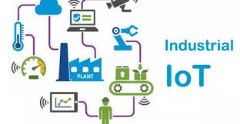



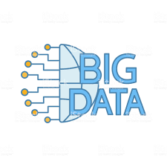

Pervasive Analytics
Technology
Enablers
EDGE & EMBEDDED
ANALYTICS
IoT
Sensors
Control Systems
STREAMING & EVENT DATA PIPELINES
Local Predictive model execution at the point of need.
Autonomous customer, value chain and industrial processes
Third Party
Public
Data
PRODUCTION
ANALYTICS
Production service level predictive model execution, machine learning operations and digital twins
BATCH DATA PIPELINES
IT SYSTEMS
DASHBOARDS
Self-service business and process intelligence
Supporting operator actions and
business decision making
DISCOVERY
ANALYTICS
Advanced visualisation, machine learning and predictive model development and training
Third Party
Public
Data

Slide 4
D&A Layered Arch

Slide 5
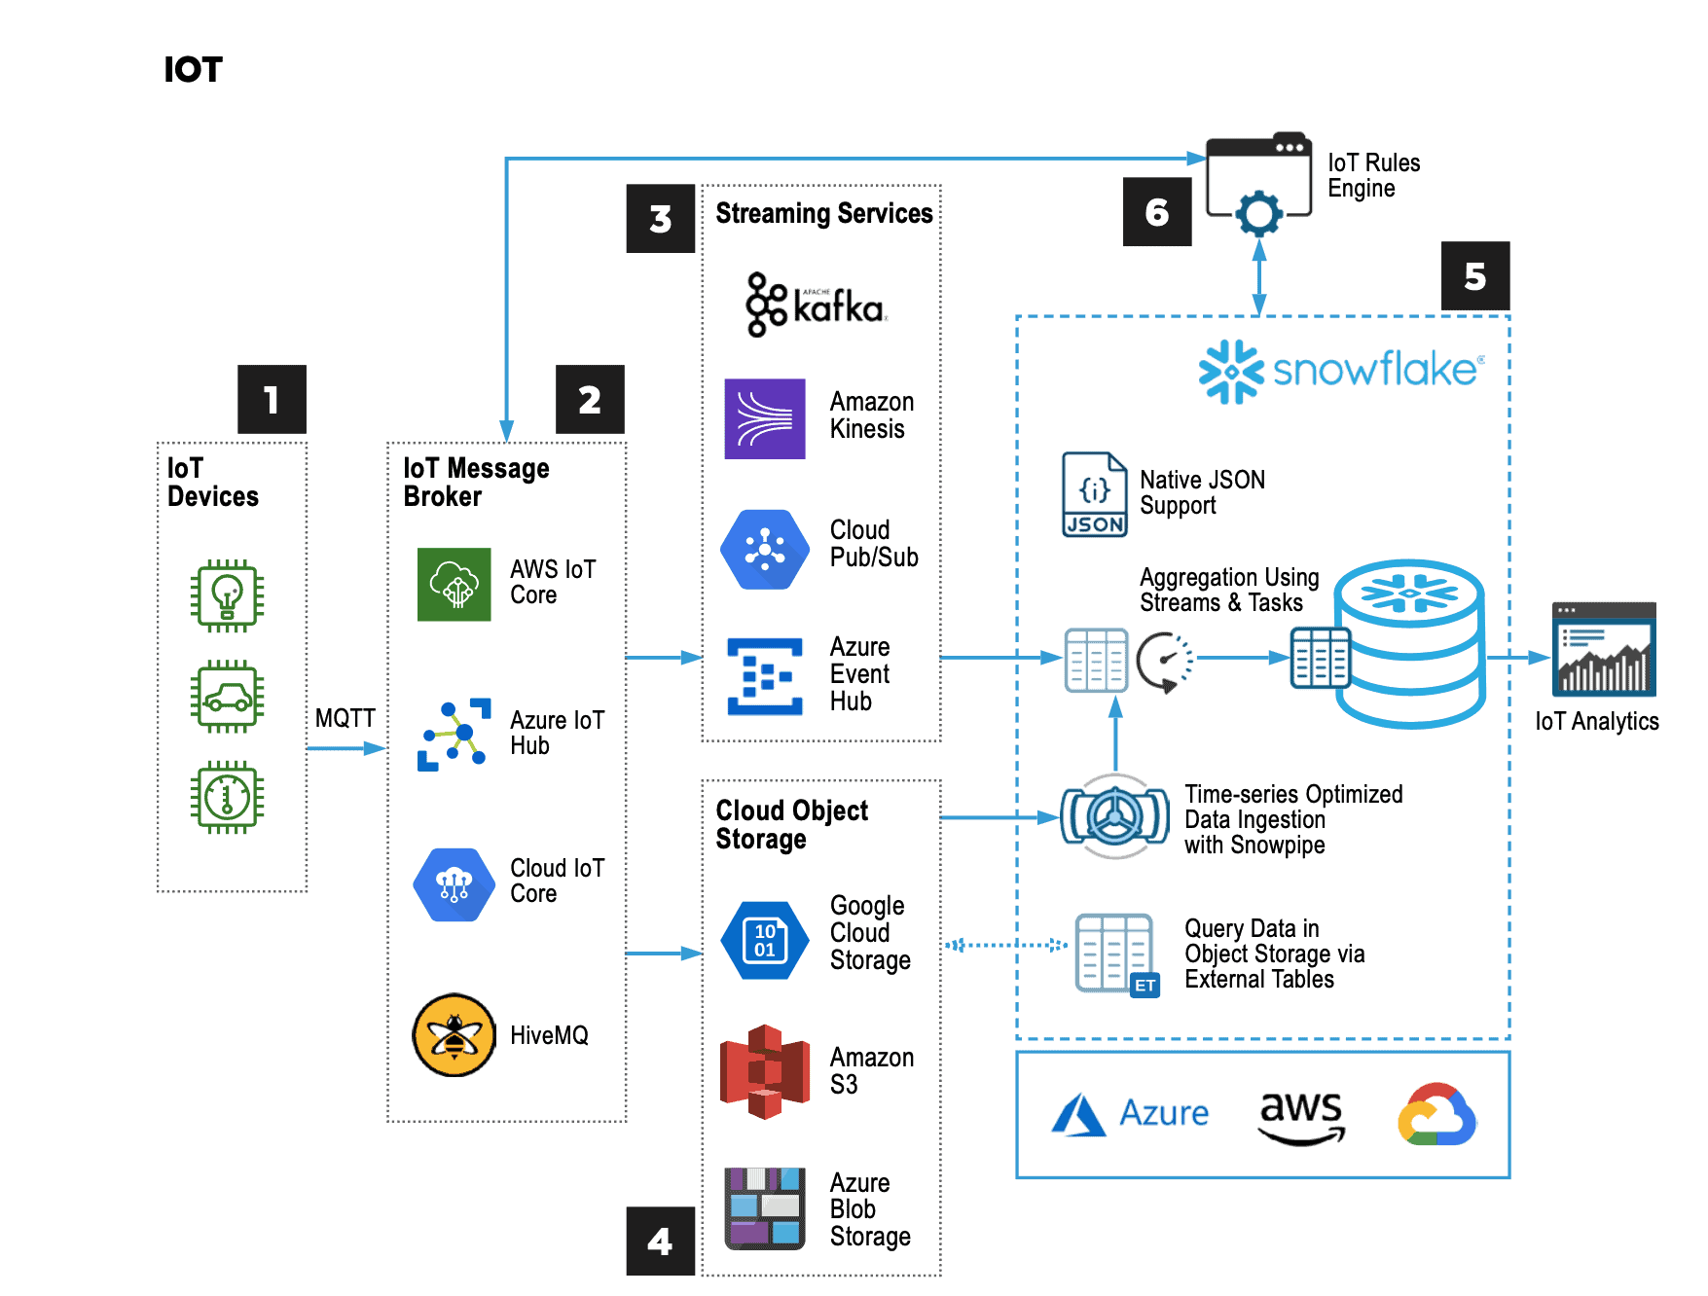
Snowflake modern reference architecture: https://www.snowflake.com/blog/modern-reference-architectures-for-application-builders/

